Slide 1

Projektpräsentation SE: Arschloch
Gruppe 5: Ralph Segi, Jan Kaiser

Slide 2
Gliederung
Organisation: (Thema 2 u. 3)
Scrum
Git
TUI Development (Thema 4)
MVC
Model/Controller Code Coverage
Design Patterns
Components & Interfaces
Dependency Injection

Slide 3
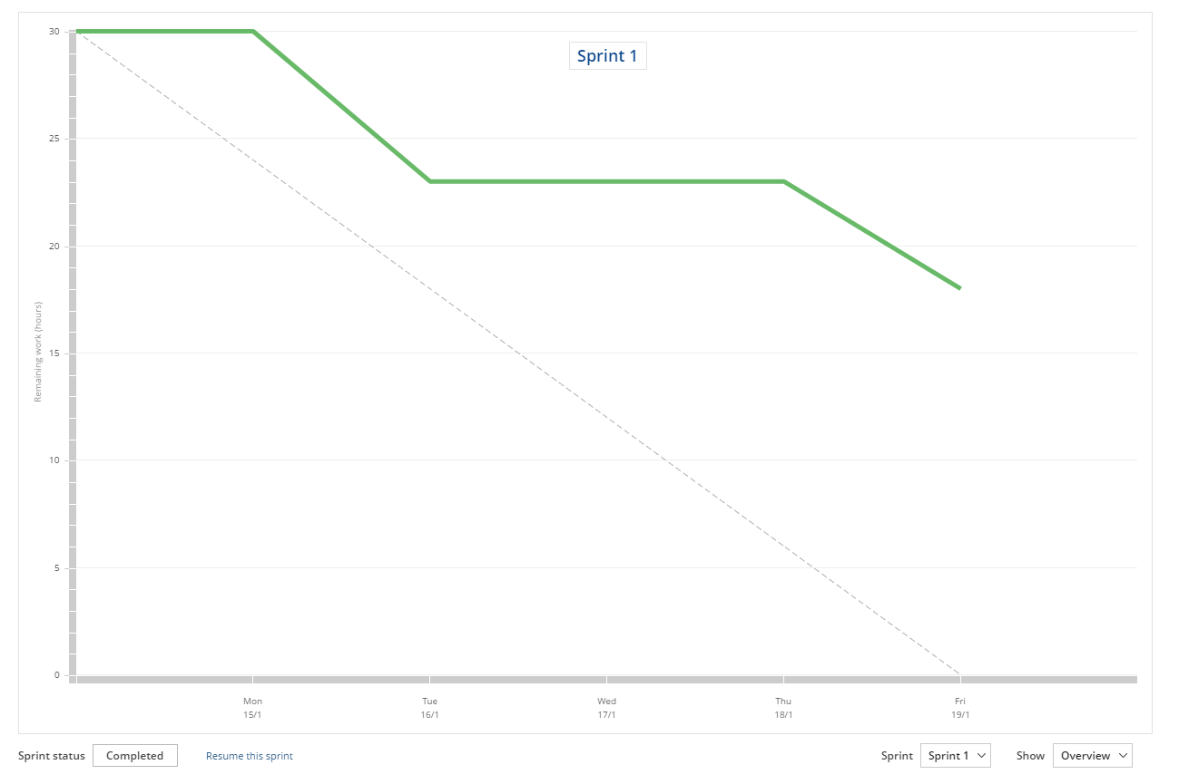
Scrum – Sprint 1

Slide 4
Scrum – Sprint 2
<insert Sprint 2 Burndown Chart>

Slide 5
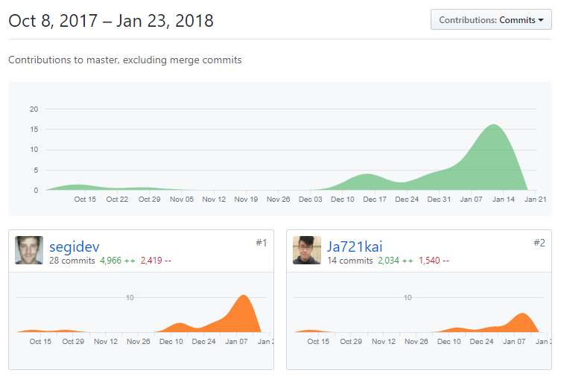
Git - Contributers

Slide 6
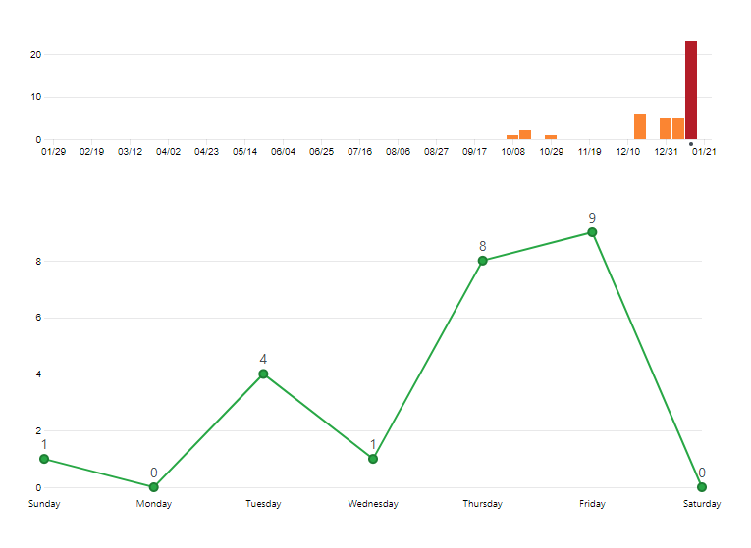
Git – Commits (Sprint 1)

Slide 7
Matching Textual Input
<Codebeispiel TUI Pattern Matching>

Slide 8
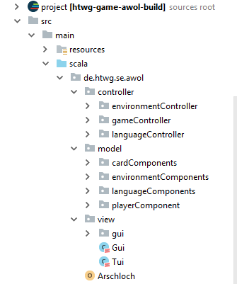
Model-View-Controller Architektur

Slide 9
Code Coverage / Tests
<insert picture of CC>

Slide 10
Design Patterns
Observer
Singleton
Strategy/State Pattern

Slide 11
Observer Pattern
<Code Example / Code Structure picture> / UML Diagramm

Slide 12
Singleton
<Code Example>

Slide 13
Strategy / State Pattern
Eins von beiden aufzeigen, evtl Strategy (LanguageHandler) für Dependendy Injection verwenden

Slide 14
GUI Development
<Code Example>
Scala Future

Slide 15
Components & Interfaces
<Code / Structure picture>

Slide 16
Dependency Injection
<Code Example>

